Slide 1
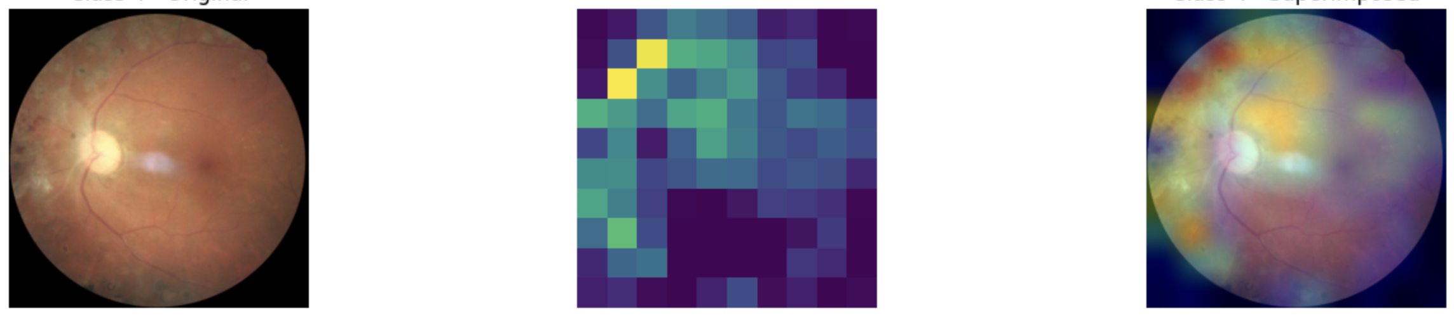

Image Classification of Diabetic Retinopathy with CNN
Hiroya Taguchi | SEM | SoSe 2024

Slide 2
Agenda
Introduction
- Diabetic Retinopathy
- Project Goal
- Data Set
Task
Code Presentation
Result
Discussion
Conclusion

Slide 3
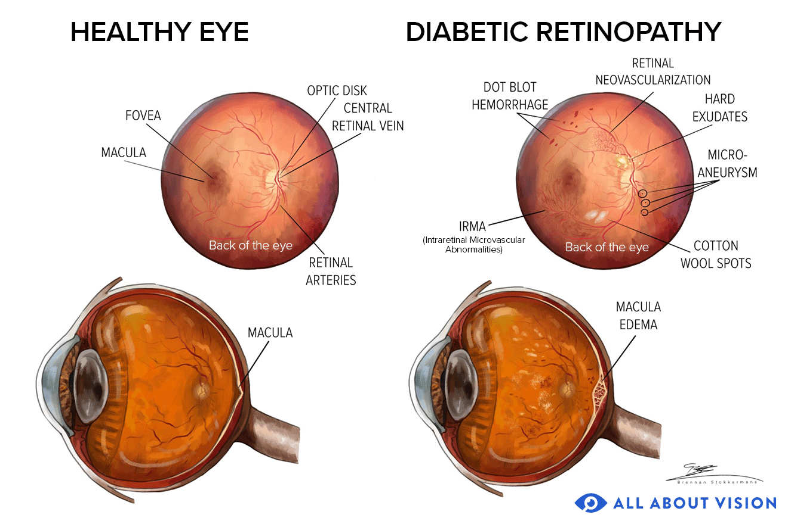
Introduction
Diabetic Retinopathy:
Vision-threatening damage to the retina of the eye caused by diabetes.
Project Goal:
Train a classifier to distinguish between the different stages of Diabetic
Retinopathy and Evaluation.
https://www.allaboutvision.com/conditions/diabetic.htm

Slide 4
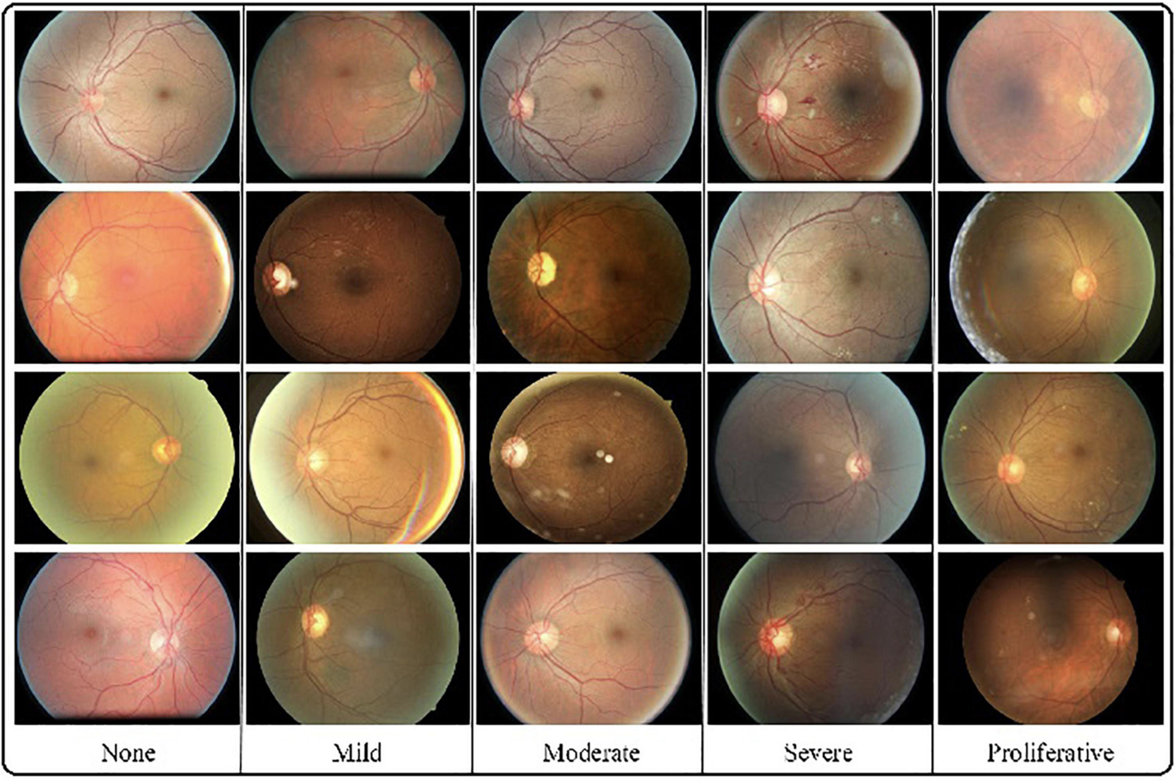
Introduction
Data set:
Classes: 1 normal and
4 classes of Diabetic Retinopathy’s images
Training Set:
600 – 900 images per class
Test Set:
100 images per class
https://www.frontiersin.org/articles/10.3389/fmed.2022.872214/full

Slide 5
Task
Prepare the data using data augmentation
Train the model using transfer learning
Evaluate the model by losses and accuracies
Generate the confusion matrix and the heat map

Slide 6
Code Presentation
See the link below:
https://colab.research.google.com/drive/1MejtLdiBBzUWYpRxldBdfkGlMBLYRTFS#scrollTo=VdQhpkw1eqxD

Slide 7
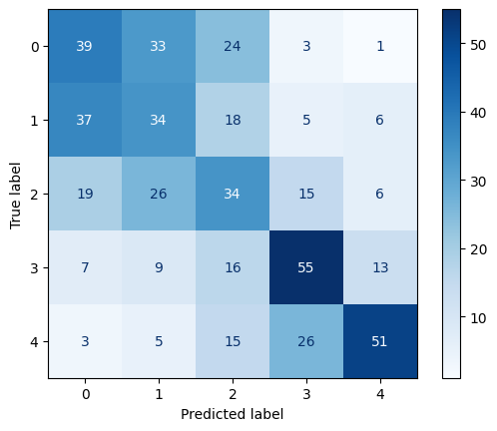
Result
Accuracy: 43.4%
Confusion matrix:

Slide 8
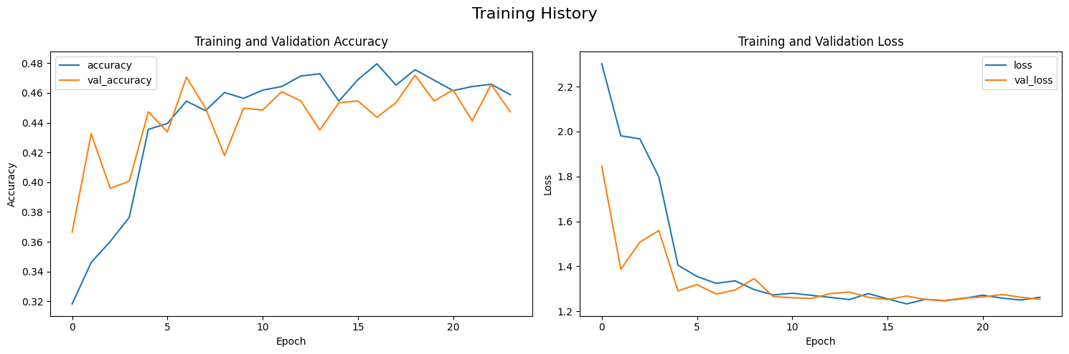
Discussion
Although the loss and accuracy improve with each epoch, there is no tendency to improve further
To improve accuracy, consider the following:
Ensure sufficient training data
Adjust hyperparameters
e.g. learning rate, epochs, batch size
Adjust data augmentation parameter
Consider using different base models
Adjust the current architecture
e.g. dropout rates, normalization

Slide 9
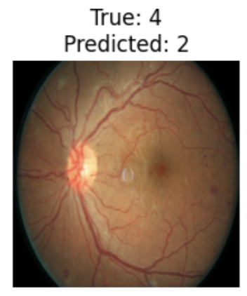
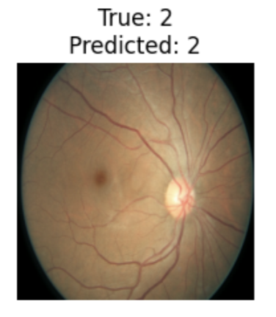
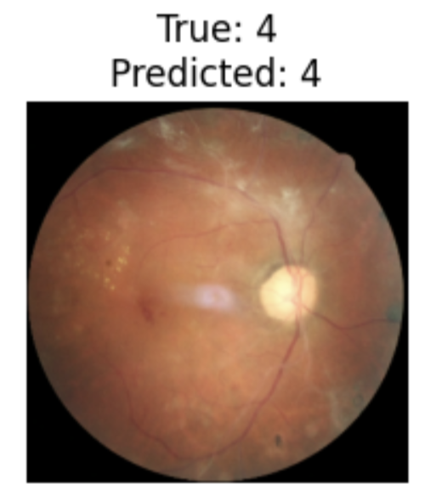
Discussion
Review and exclude relatively ambiguous examples from the data
For example, the case of misclassification, where an image label as class 4 is detected as class 2 because the features are not easily distinguishable.
Reducing the classification categories from five levels to two or three may also improve the model accuracy.

Slide 10
Conclusion
Achieved 43% accuracy under the current training conditions
To improve accuracy, ensure enough training data, adjust hyperparameters and data augmentation, try different base models, and tweak the architecture.
If the accuracy enhanced, there is potential for using the model training in actual medical diagnoses, not only for eye conditions but also for other medical images like X-ray.

Slide 11
THANK YOU!

Slide 12
The severity of each grade of Diabetic Retinopathy
• None(0): no apparent retinopathy (no abnormalities).
• Mild(1): mild non-proliferative diabetic retinopathy (microaneurysms only).
• Moderate(2): moderate non-proliferative diabetic retinopathy (more than microaneurysms but less severe non-proliferative diabetic retinopathy).
• Severe(3): severe non-proliferative diabetic retinopathy (any extensive intraretinal hemorrhages in each of the four quadrants, definite venous beading in 2+ quadrants, prominent IRMA in 1+ quadrant, and no signs of proliferative retinopathy).
• Proliferative(4): proliferative diabetic retinopathy (one or more neovascularization and vitreous/preretinal hemorrhage).
As introduced in the datasets, the graders were CN-licensed ophthalmologists and had diabetic
retinopathy diagnosis experience of at least 5 years.

Slide 13
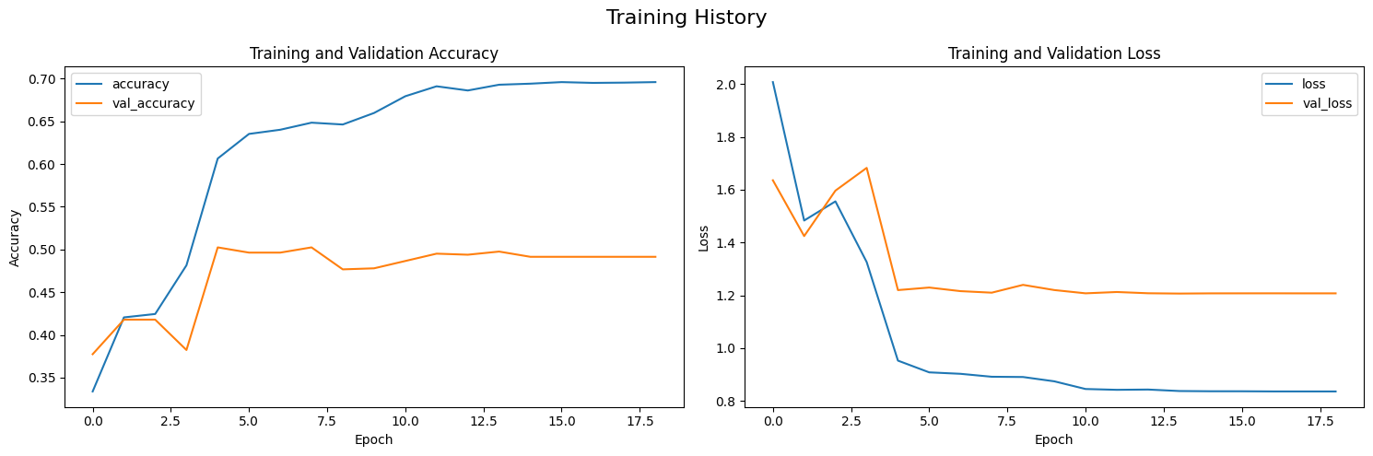
Discussion
Although the loss and accuracy on the training set improve with each epoch, the loss and accuracy on the validation set do not change, indicating overfitting
To avoid overfitting, consider the following:
Sufficient training data
Adjust data augmentation parameter
Consider using simple base model
Adjust the current architecture by modifying dropout rates and adding normalization layers.

Slide 14
Discussion
Synthetic Data Generation: Use generative models like GANs (Generative Adversarial Networks) or VAEs (Variational Autoencoders) to generate synthetic data and augment the dataset.
Applying Sample Weights: Assign weights to specific samples in the dataset so that the model can pay more attention to important samples.

